Slide 1


Sentimental Analysis on YouTube
Sameera Turupu Aditya Bhamidipati
Master’s Computer Science
Georgia State University
Notes:
Good afternoon everyone, Sameera and I worked on the sentimental analysis of YouTube as our course project
Let’s give a brief on our project

Slide 2


Introduction
world’s largest video sharing platform
irrelevant results based on likes and views
Comments play a active role to the actual polarity
Search results are title and tag based
Notes:
YouTube is one of the world’s largest video sharing platforms, where videos are uploading continuously by the millions of users.
When we search for a speciﬁc video through some keyword on a topic, the most popular video comes, which are rated based on views/likes by the users
Sentimental analysis on comments along with likes, dislikes and views helps to correctly classify the polarity of the video. In a sense if they are positive or negative.
Search results also focus on title and tags, so analysis on tags will help increase the popularity of a video

Slide 3
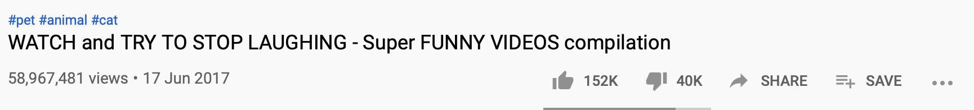
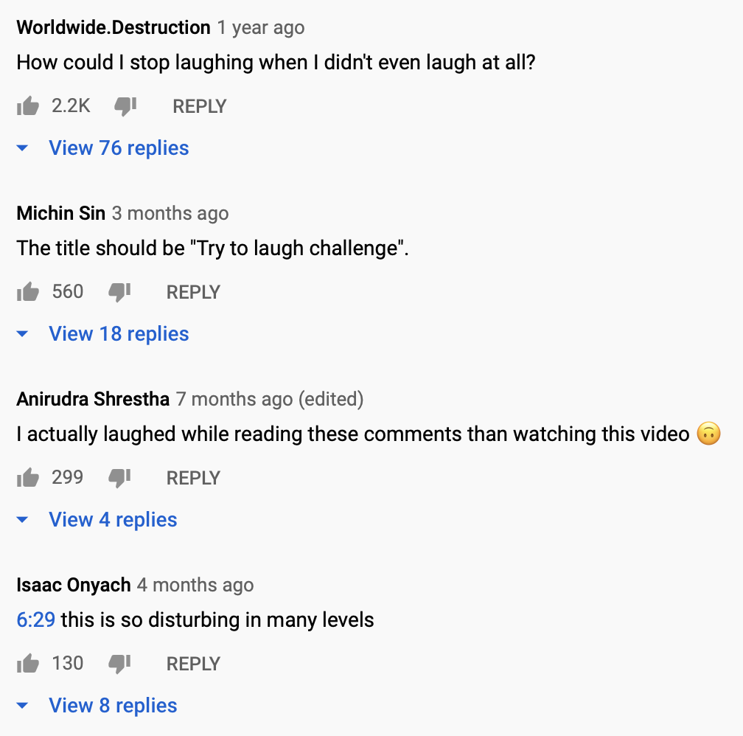
Motivation
Likes can be misleading which is why comments are also necessary for determining the polarity of a video
Tag is another measure of how popular a video is.
E.g., #funny, #dogs, #crazy
Notes:
Generally, the quality, relevance, and popularity of the video is maintained based on likes, dislikes, views and tags. Sometimes irrelevant and low-quality videos ranked higher in the search result due to the number of views or likes, which seems untenable.
What if there were a way to judge the response to a video based purely on its youtube comments? And how does it justify based on number of likes and dislikes.
Additionally, Tags play an important role especially for youtubers as they earn money from advertisers based on their views. They often ponder with the question “What type of videos should i make in order to get more user views?” and more specifically what should be the title and tags to attract users.
To minimize these issues, we present a sentimental data analysis approach to user comments and tags.

Slide 4

Next Steps
Input description
Exploratory data analysis
Data Preprocessing
Architecture
Comment analysis
Data pipeline
Tag analysis
Collaborations
Notes:
Moving on to the next steps, we’ll talk more on the input description, Exploratory data analysis, Data preprocessing, Architecture, Comment analysis, Data pipeline and finally Tag Analysis
Sameera will take over the input description.

Slide 5
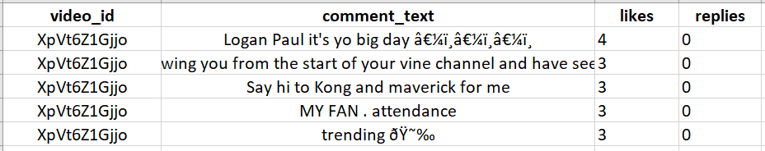
Data description
Rows: ~50000
Source: https://www.kaggle.com/datasnaek/youtube-new
Notes:
Hi Everyone,
There are two kinds of data files, one includes comments and one includes video statistics.They are linked by the unique video_id field.
The headers in the comments file are:
video_id (Common id field to both comment and video csv files)
Comment_text
likes
replies
Number of Rows - 50,000
The source of our input data is from Kaggle datasets

Slide 6
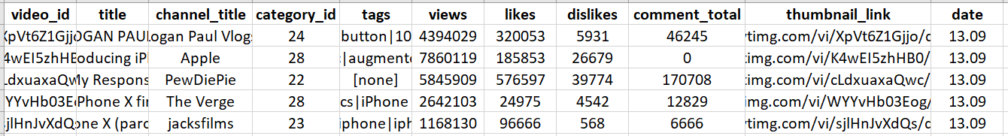
Data description contd..
Rows: ~50000
Source: https://www.kaggle.com/datasnaek/youtube-new
Notes:
Coming to the video file
The headers are:
video_id (Common id field to both comment and video csv files)
title
channel_title
category_id
tags (Separated by | character, [none] is displayed if there are no tags)
views
likes
dislikes
thumbnail_link
date (Formatted like so: [day].[month])
This has ~5000 records

Slide 7
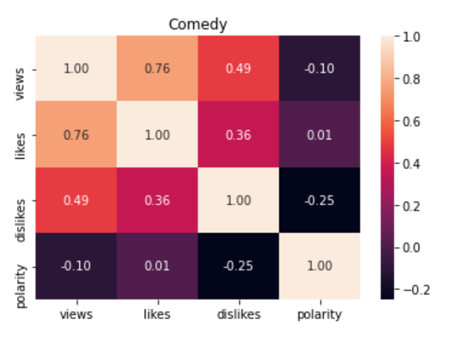
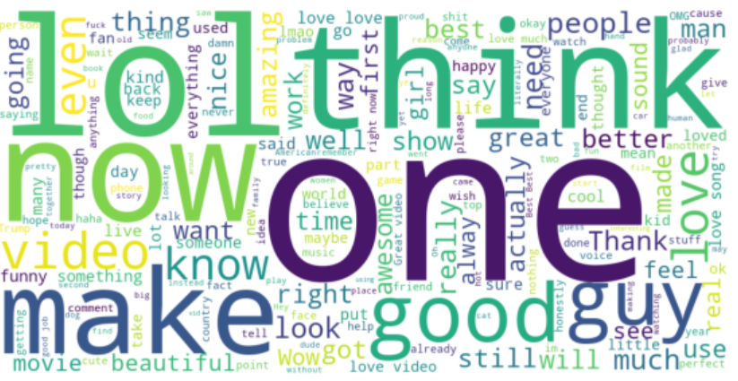
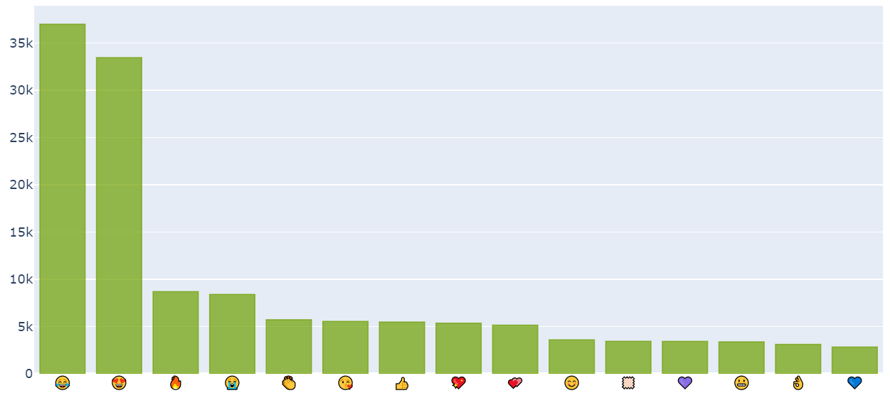

Exploratory data analysis
Notes:
Coming to the exploratory data analysis
Here is the word cloud for positive comment sentences as you can see the words lol, think etc are most used in the positive comments
We have also built a correlation matrix for each category like comedy, entertainment etc showing the correlation between likes, views, dislikes and polarity of the comments.
The values of the correlation coefficient can range from -1 to +1. The closer it is to +1 or -1, the more closely are the two variables related.
The positive sign signifies the direction of the correlation i.e. if one of the variables increases, the other variable is also supposed to increase.
Here as you can see views and likes are highly correlated whereas dislikes and polarity are least correlated which means the number of dislikes is not proportional to comments polarity for comedy category.
And then coming to the most used emoticons in the comments as we can see “Face with Tears of Joy” emoji is mostly used and the “blue heart” emoji is the least one used.

Slide 8
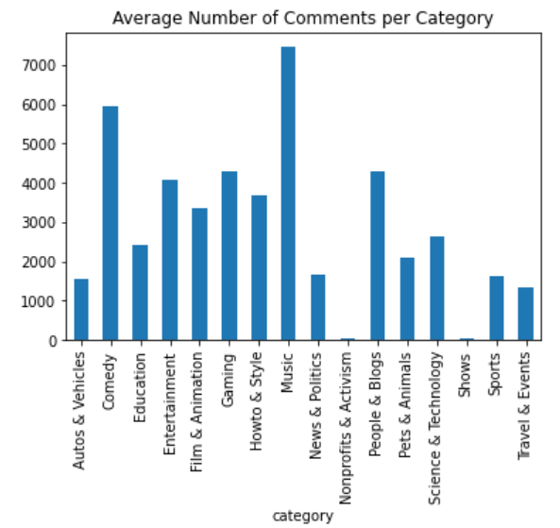
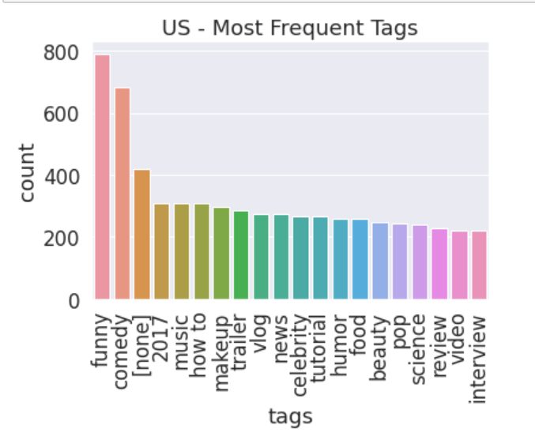
Exploratory data analysis contd..
Notes:
Continuing the EDA
Here is an analysis on most frequent tags on US YouTube videos. As you can see, funny and comedy tags are highly used. Review and interview are least used tags on US Youtube videos.
An analysis on average number of comments per category states that Music videos have highest number of comments, Next comes comedy category. Also, Nonprofits and activism as well as shows have the least number of comments.

Slide 9





Technology Stack
Notes:
As we mentioned earlier, our dataset source is from Kaggle.
We have used jupyter notebook as the development platform for our project. And integrated it with Apache spark to perform the spark operations like Spark SQL, Spark ML and the regular rdd operations.
For visualizations we used matplotlib, plotly and tableau and integrated them in our project.

Slide 10
Data preprocessing
Removing Punctuations, Numbers and Special Characters
Removing Short Words
Changing the text to lowercase
Tokenization - “This is a sample” -> [“This”, “is”, “a”, “sample”]
Lemmatization - example: “singing” -> “sing”
Notes:
This phase essentially remove the unwanted data from the whole dataset to tune it for better analysis. Because the words like is, or, an etc., don’t add weight for our analysis as we mainly concentrate on the adjectives and verbs like happy, funny, sad, cry etc.,
We performed data pre-processing in 5 stages
As a first step, We have removed punctuation marks, numbers and special characters using regular expression
And then Short words - words with length less than 3 are also removed as they will mostly be stop words or abbreviations
Next Lowercase - made the text case insensitive for consistent processing
And then Tokenized the comment text - Tokenization is a step which splits longer strings of text into smaller pieces, or tokens.
Finally Lemmatization - which is converting different forms of a single word to its root form.

Slide 11
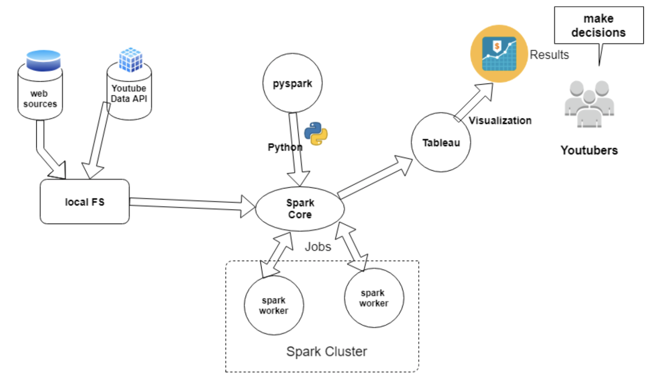
Architecture
Notes:
Let’s talk a little bit on the architecture of the project
The data extracted from youtube api or kaggle data set are saved to local file system in KVM. For now we have considered Kaggle as our data source.
Data from local system is loaded to spark engine using pyspark API (python)
Spark sends data and tasks ie map and reduce to worker nodes to do the parallel processing.
Spark sends output back to the local system when output is fed to matplotlib and tableau for visualizations and the results are used for decision making

Slide 12
Comment analysis
Input - Preprocessed data
TextBlob for finding the polarity of comments in RDD
Aggregated the total comments, likes, views and dislikes for a video using Spark SQL
Applied Logistic Regression on analyzed data using Spark ML
StringIndexer - label encoding
OneHotEncoderEstimator - categorical value represents the numerical value of the entry in the dataset.
VectorAssembler - takes multiple columns as input and outputs a single column
Accuracy - ~79%
Notes:
Coming to the crux of the project
After preprocessing the data, it is given as input to RDD
We have used textblob, a python library for processing textual data (comments text)
It provides a simple API for diving into common natural language processing (NLP) tasks such as part-of-speech tagging, noun phrase extraction, sentiment analysis, classification, and translation
After the polarity determination data is collected from RDD.
Using Spark SQL joins(), we have aggregated USVideos and USComments files for a temporary view entailing the comments, likes, views and dislikes
We also worked with a machine learning model using spark ML that can classify the polarity using logistic regression
As a preprocessing step for ML model, firstly we used stringindexer which maps a string column of labels to an ML column of label indices. If the input column is numeric, we cast it to string and index the string values. It must be applied before the OneHotEncoder
Using one hot encoder, the features are encoded using a one-hot (aka ‘one-of-K’ or ‘dummy’) encoding scheme. This creates a binary column for each category and returns a sparse matrix or dense array (depending on the sparse parameter). Now this data can be provided to ML algorithms to do a better job in prediction.
Next the VectorAssembler class takes multiple columns as input and outputs a single column whose contents is an array containing the values for all of the input columns.
After the preprocessing, we trained the model and obtained an accuracy of 79%
The sentiment outputs will be briefed by sameera

Slide 13
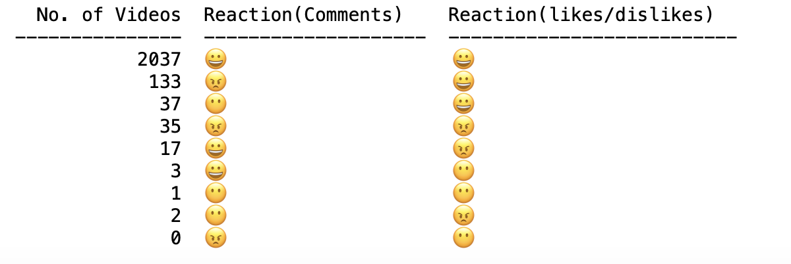
Comment Analyis Contd.
Notes:
This is the output of our analysis with respect to comments and reactions (likes/Dislikes)
We have assigned Grinning Face emoticon is for a positive reaction, Face Without Mouth emoticon is for a neutral reaction, Angry Face emoticon is for negative reaction
As you can see for most videos, The reaction with respect to comments and likes/dislikes is same, which is positive
But for 133 videos though based on likes it is a positive video, the comments state otherwise which is misleading
And for 17 videos, a greater number of dislikes state that the videos are negative but their comments state otherwise.

Slide 14
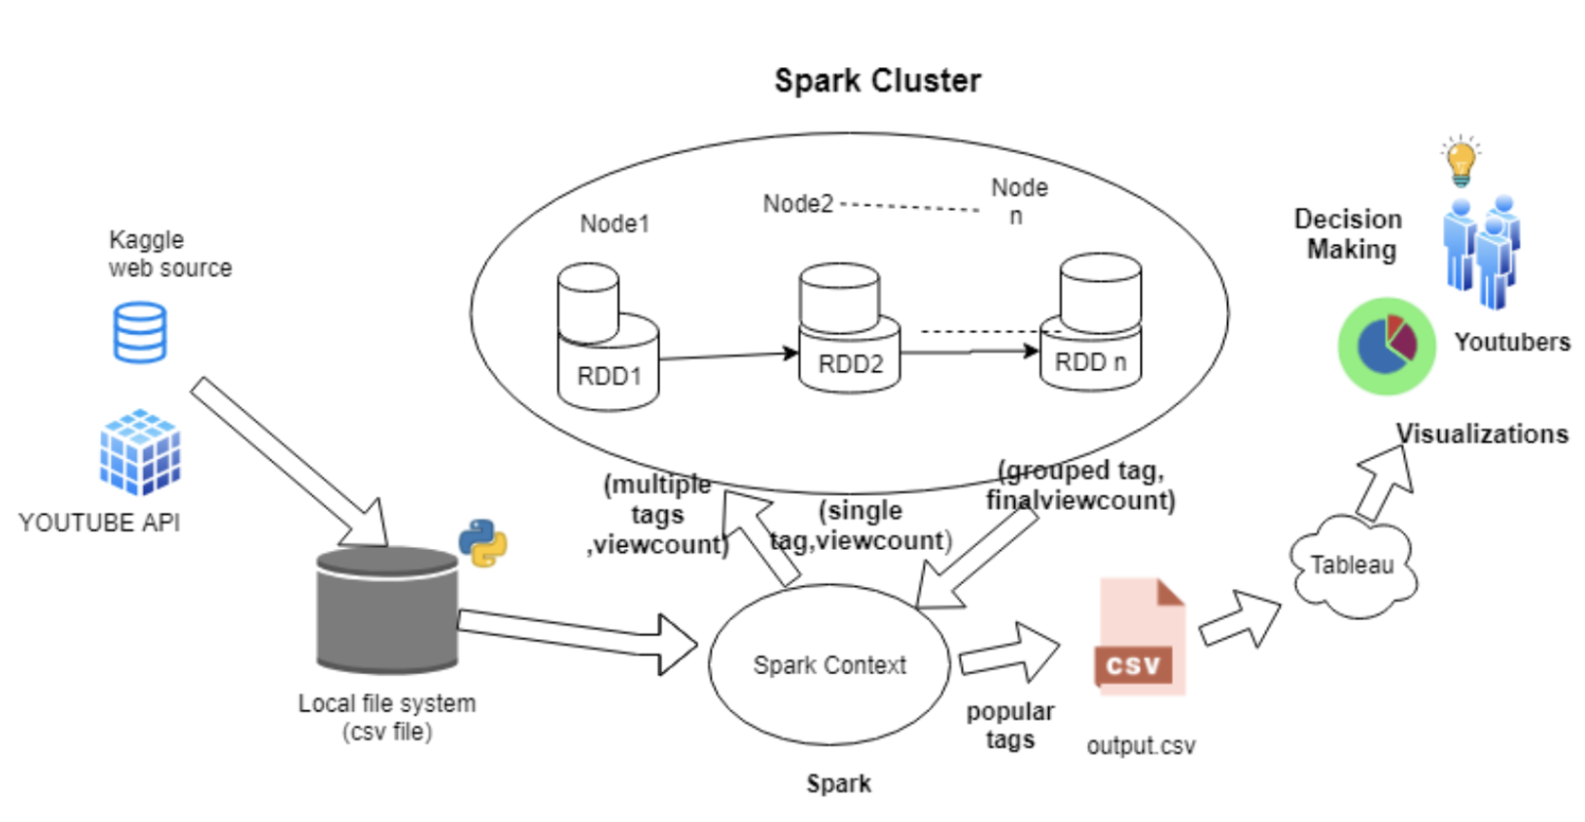
Data Pipeline for Tag Analysis
Notes:
Another data analysis that we performed is on Tags. Let’s now look at data pipeline for tag analysis.
Here we have collected data from kaggle web sources, saved locally as CSV and fed to spark.
Spark then transmits data into RDDs to its worker nodes. First the initial input is a multiple tags for a video and their view count. A tag is taken at a time in the map phase and All the unique tags are grouped by summing their view counts. all the worker nodes execute their tasks and send the sorted output back to the local FS(which is our KVM)
Outputs are visualized in tableau for decision making.

Slide 15
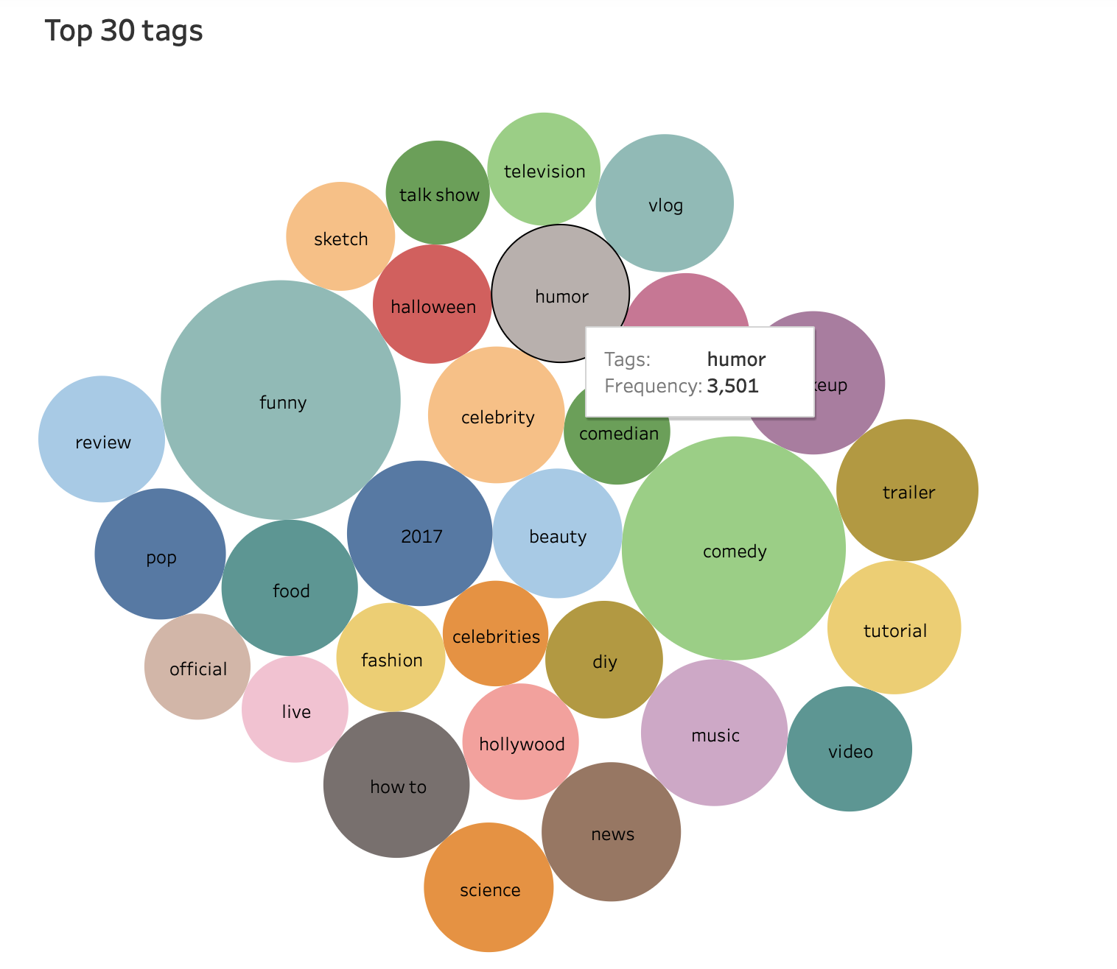
Tag Analysis
Notes:
.* We read data from local FS and select only tags and views columns into RDD
We then split tags by separator and associate each tag with view count and reduce by same key
We then applied log on views because they could sum to large values
Finally we sorted the top trending tags by view count and have written it to disk.
From the packed bubble visualization it is evident that during the time data is collected, comedy and funny videos grab the most user views. Any YouTubber can choose video content with the help of trend visualization.
This tableau visualization in juypter notebook

Slide 16
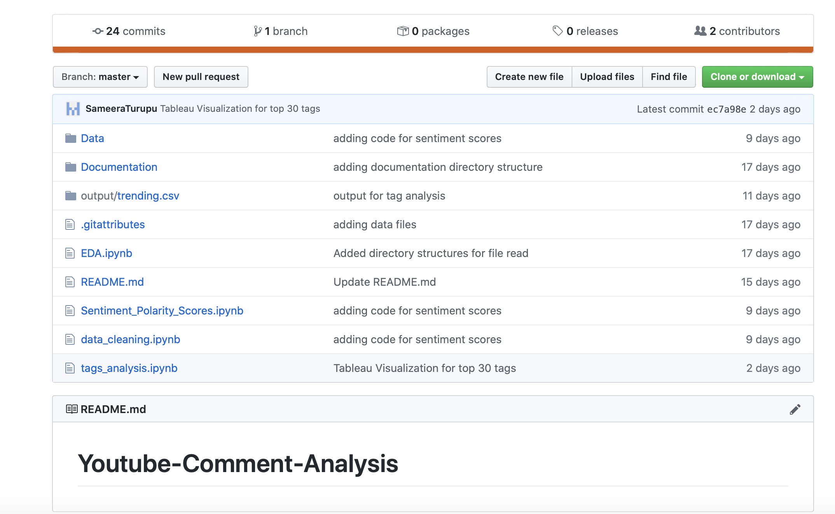
Github
Notes:
We have used Github as a version control system for collaboration and revisioning

Slide 17
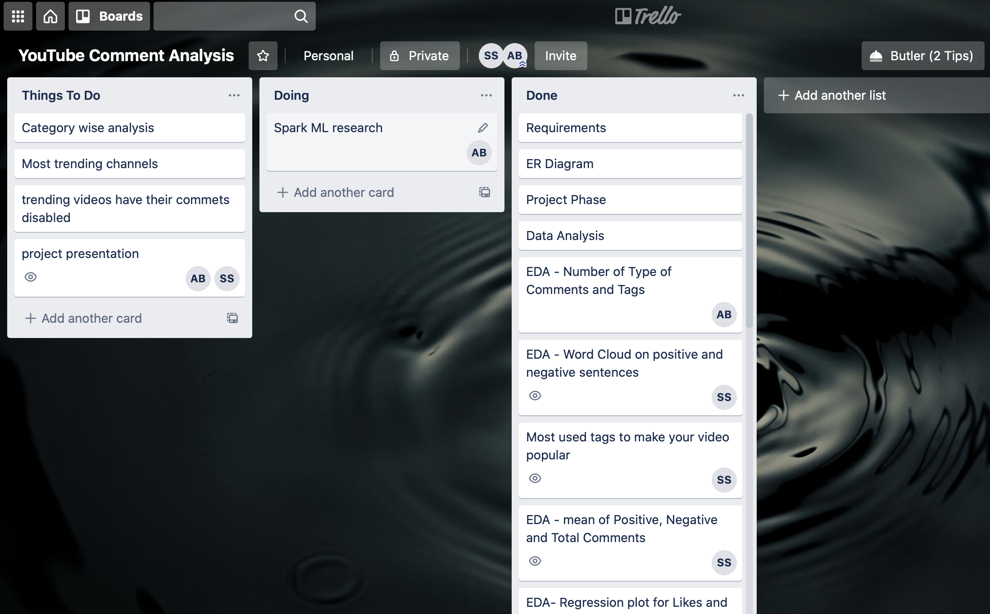
Trello
Board
Notes:
We have used the trello tool to define workflow, manage tasks and track the progress of work done by the team

Slide 18
Thank You

